Slide 1

Applied Machine Learning
Suspicious URLs Detection
Piyush Raisinghani
Sanika Jadhav
Varun Bhavnani
Vishu Yadav
Yash Ruparelia

Slide 2




AGENDA
Suspicious URLs Case-Study
Data Understanding
Analysis Approach
Predictive Model Development

Slide 3

Suspicious URLs Case-Study

Slide 4






Suspicious URLs Detection
Case-Study
Essential steps towards secure web browsing
This URL identification is a multi-classification problem, and this can be done by using various algorithms that are present in Machine Learning. We will be focusing on multiple Classification Algorithms. We will report the accuracies on each model and choose the best one for predictions.
Business Perspective
Phishing emails, malicious URLs, sending fake text messages, and other methods are frequently used to carry out online illegal practices
it is essential to identify malicious URLs on the internet and add them to a blacklist to prevent user attacks
Running multiple classification ML models in order to achieve the best prediction to identify Suspicious URLs
Business Challenges
Technical Challenges
Traditional solutions are lacking stability in identifying and dealing with the un-ethical web browsing activities
In-sufficient Labeled data The labeled data is not in abundance and identifying key variables is lacking
The cost of gathering the URL data very high and requires a lot of compliance clearance
Lack of centralized analytical platform that can generate the required data for URL detection and provide results instantly

Slide 5

Data Understanding

Slide 6
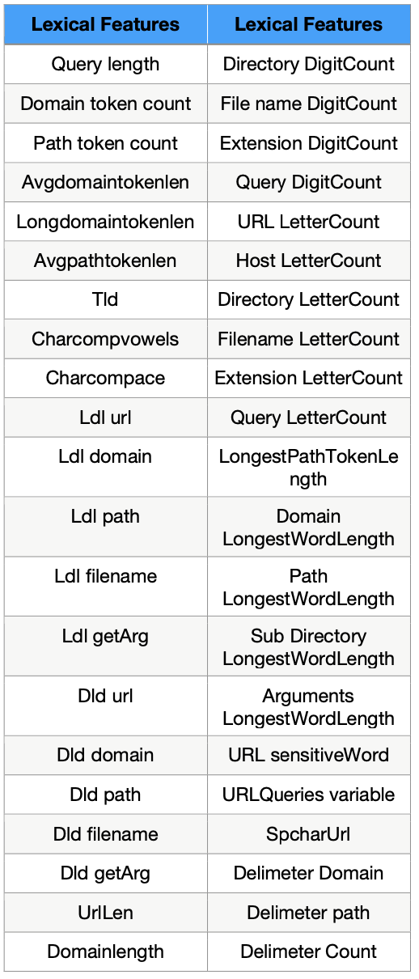
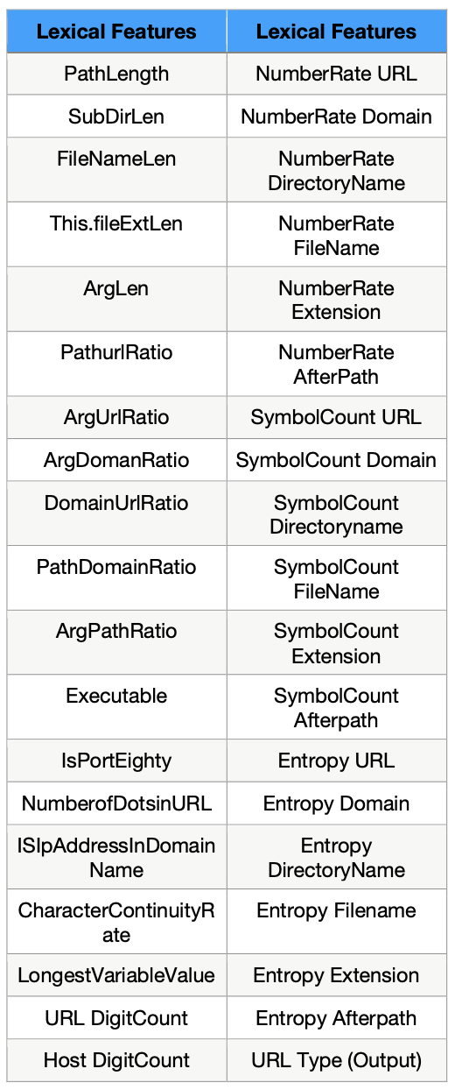
Data Set Description
Mean values of the cell area
Lexical features can be considered as the textual properties of an URL like QueryLength, DomainLength, URL LetterCount, Length of the HostName etc. Lexical Features are lightweight in nature so, it takes less time for computation and due to its lightweight property, it is popular in the field of Machine Learning [15]. The Lexical features are extracted from an URL and it does not depend on any specific application like email, social networking websites etc. Since most of the Malicious or Spam URLs have a short life span, the features that are extracted will remain present and can be utilised to detect new incoming Malicious URLs even when the old Malicious URLs are unavailable
Notes:
Total rows: 60,000
Features: 78

Slide 7

Analysis Approach

Slide 8
Model Development Approach
Stage wise approach to build the best model
Logit Statistical Analysis
Running Various Classification Models
Ensemble Learning
Descriptive Statistics
Exploratory Data Analysis
Multicollinearity Check
Running Various Classification Models
Ensemble Learning
Best Model
Approach 1: Model Development with Statistical Analysis Approach
Approach 2: Model Development without Statistical Analysis Approach

Slide 9

Predictive Model Development

Slide 10

Model Goals & Objectives
Setting up the goals for model development
Correctly classifying Target Variable: URL Type: Benign (0), Defacement (1), Phishing (2), Malware (3), Spam (4)
Developing Classification with minimum features
Identifying a ML model with the best accuracy
Determine the features that are highly associated with Non-Benign URLs

Slide 11
Feature Engineering
Approach 1 vs Approach 2
Approach 1
Approach 2
78 Features
78 Features
37 Features
37 Features
Multicollinearity Check
Multicollinearity Check
27 Features
Logit Analysis

Slide 12
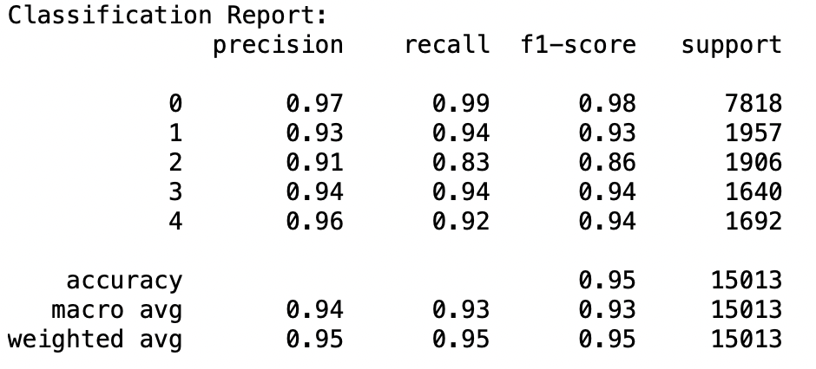
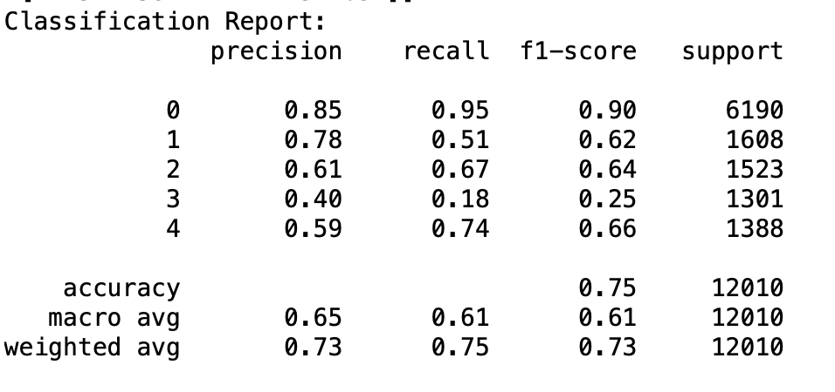
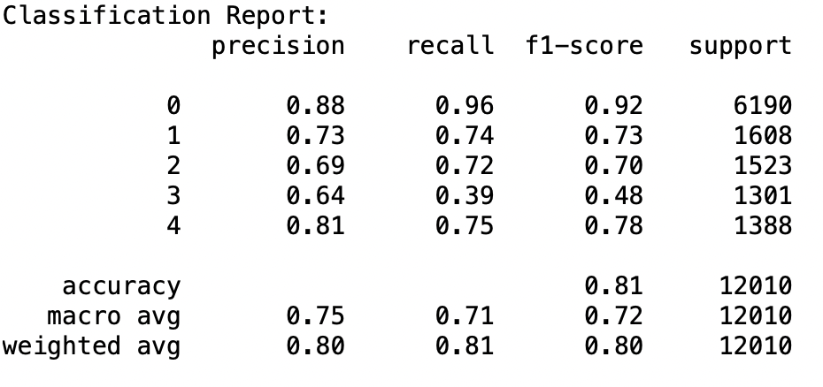
Approach 1 ML Model Summary
Comparing all the model performance
KNN
Decision Tree
Logistics Regression Multinomial Model
Hyperparameters:
max_depth': 5, 'max_leaf_nodes': 10, 'min_samples_split': 2
Hyperparameters: K = 3
Hyperparameters: C: 0.1, Penalty: L2
Accuracy: 95.23%
Accuracy: 74.92%
Accuracy: 81.27%
Notes:
We performed GridSearch and found these to be the best/optimal parameters

Slide 13
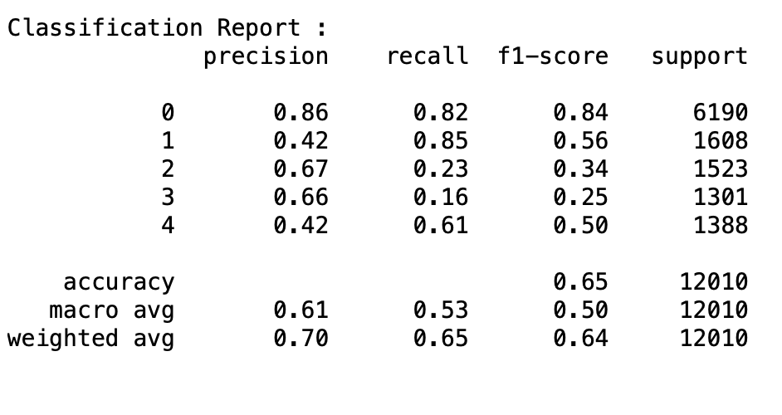
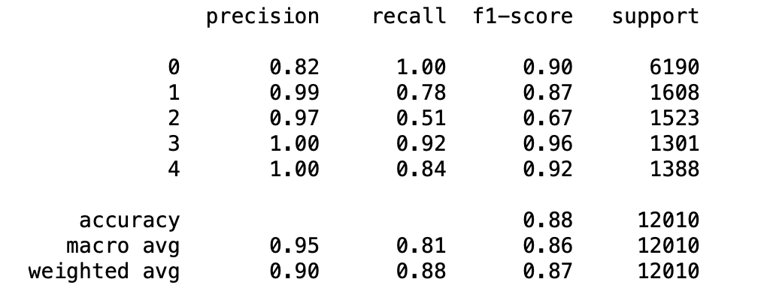
Approach 1 ML Model Summary
Comparing all the model performance
Naive Bayes
Support Vector Machine
Hyperparameters: priors: None 'var_smoothing': 1e-09
Hyperparameters: C=0.1, gamma=0.01, kernel=rbf
Accuracy: 65.2%
Accuracy: 88%

Slide 14
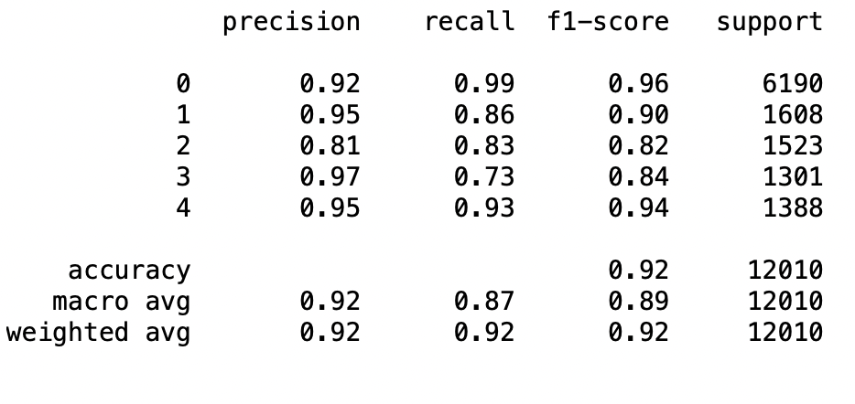
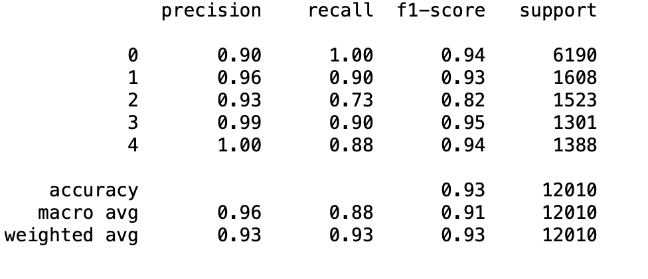
Approach 1 ML Model Summary
Comparing all the model performance
Ensemble Learning: Random Forest
Ensemble Learning: Voting Classifier
Hyperparameters: {'criterion': 'entropy',
'max_depth': 8,
'max_features': 'auto',
'n_estimators': 500}
Hyperparameters: ('lr1', regularized_lr), ('svc', rbf), ('knn', 3 )
Accuracy: 91.56%
Accuracy: 93%

Slide 15
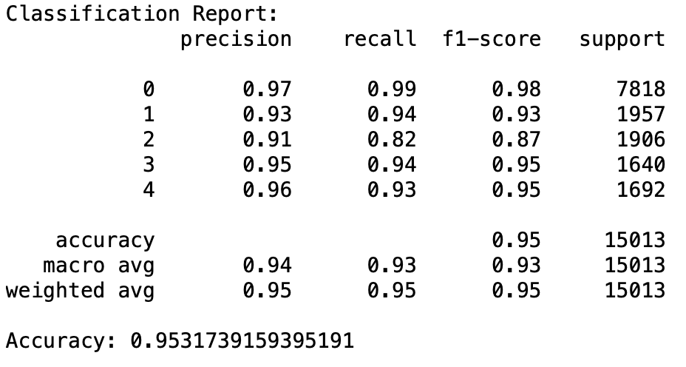
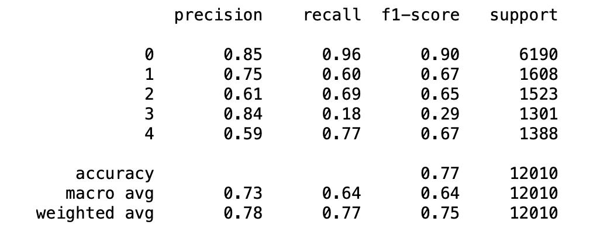
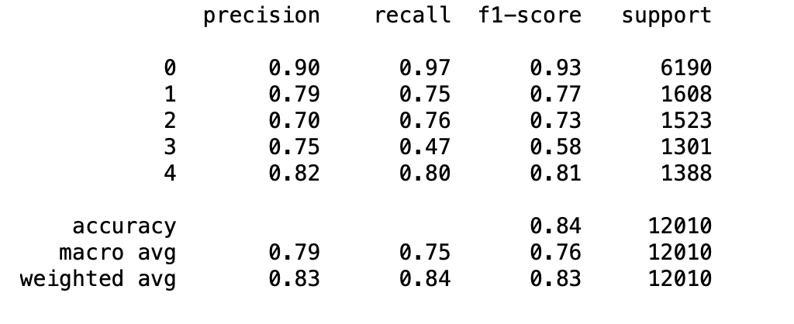
Approach 2 ML Model Summary
Comparing all the model performance
KNN
Decision Tree
Logistics Regression Multinomial Model
Hyperparameters:
max_depth': 5, 'max_leaf_nodes': 10, 'min_samples_split': 2
Hyperparameters: K = 3
Hyperparameters: C: 0.1, Penalty: L2
Accuracy: 93.75%
Accuracy: 77%
Accuracy: 84%

Slide 16
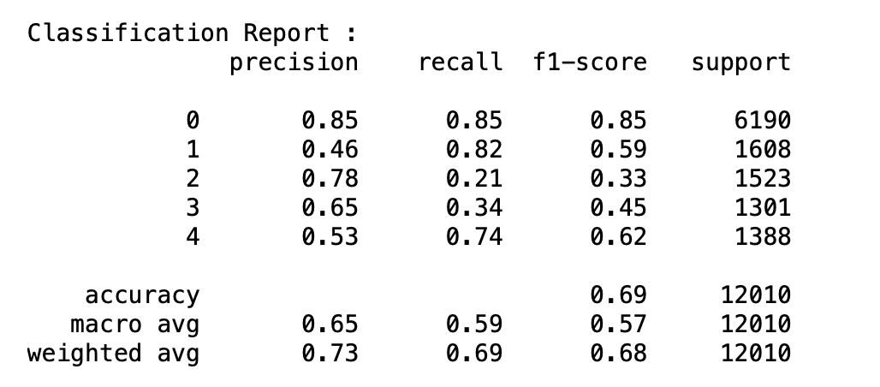
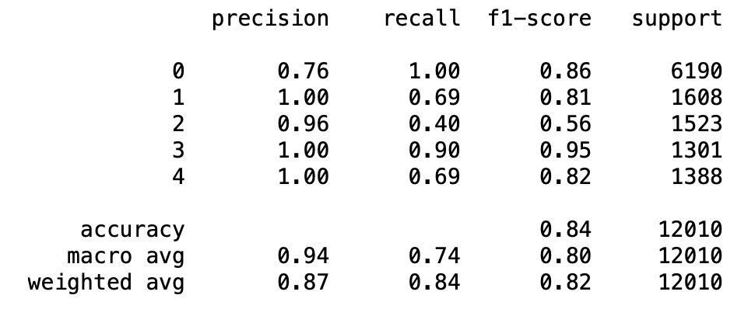
Approach 2 ML Model Summary
Comparing all the model performance
Naive Bayes
Support Vector Machine
Hyperparameters: priors: None 'var_smoothing': 1e-09
Hyperparameters: C=0.1, gamma=0.01, kernel=rbf
Accuracy: 69%
Accuracy: 84%

Slide 17
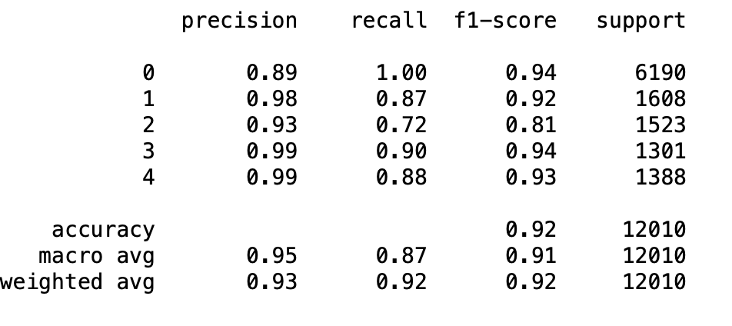
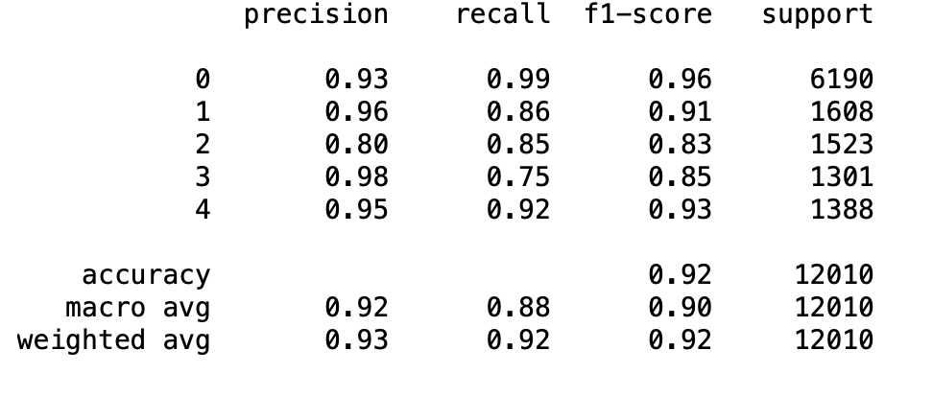
Approach 2 ML Model Summary
Comparing all the model performance
Ensemble Learning: Random Forest
Ensemble Learning: Voting Classifier
Hyperparameters: {'criterion': 'entropy',
'max_depth': 8,
'max_features': 'auto',
'n_estimators': 500}
Hyperparameters: ('lr1', regularized_lr), ('svc', rbf), ('knn', knn )
Accuracy: 92%
Accuracy: 92%

Slide 18

Model Recommendation
Predicting malignant and benign
KNN or Voting Classifier
The overall accuracy between 93% to 95%
The number of independent variables required for predicting accurately is less, just 27 out of 78 variables
Voting Classifier gives a boost to weak models and give combined results with better accuracy

Slide 19
Thank You
Notes:
Maximizing the value of data for CPG Marketers :
https://www.bcg.com/publications/2020/how-cpg-marketers-can-maximize-value-of-data
Effect of covid on CPG Industry :
https://www.fooddive.com/news/covid-19-has-fundamentally-changed-the-cpg-industry-report-says/596600/
How CPG Brands are using DTC :
https://www.forbes.com/sites/forbescommunicationscouncil/2020/10/08/how-cpg-brands-are-using-dtc-to-stay-competitive/?sh=4286bb4d4fca
Mars Website :
https://www.mars.com/made-by-mars/mars-food
Mars competitors and Revenue Information :
https://www.owler.com/company/mars
Shocking trends in CPG Industry :
https://blog.koupon.com/7-shocking-trends-in-the-cpg-industry?utm_term=&utm_campaign=FSD+DSA+Blog+US+only&utm_source=adwords&utm_medium=ppc&hsa_acc=4619971055&hsa_cam=12471288677&hsa_grp=119201009706&hsa_ad=507806212542&hsa_src=g&hsa_tgt=dsa-1270164446605&hsa_kw=&hsa_mt=b&hsa_net=adwords&hsa_ver=3&gclid=Cj0KCQjwtrSLBhCLARIsACh6Rmh2lrDC70xbyJqZDPPEU-BtuHM6iWzNZrfYVLbI4Tgv5rXHE7gQXikaAhYvEALw_wcB
Dispute between Hershey’s and Mars :
https://munchpak.com/blog/mars-and-hershey-bring-malteser-dispute-to-a-peaceful-close/

